Slide 1

The ABP Framework open-source web application framework for ASP.NET Core

Slide 2

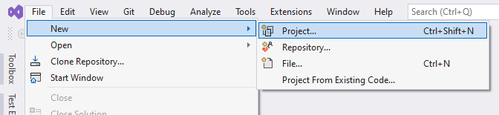

File -> New -> Project
Create a layered solution structure with the best practices
Install and configure all your favorite libraries and tools. Search for the others…
Setup your automated tests with mocking database and other infrastructure.
Create modern, responsive UI layouts with navigation, header, footer, toolbars… or apply a pre-built UI theme.
You already spent your weeks before writing a single line of your business code!

Slide 3
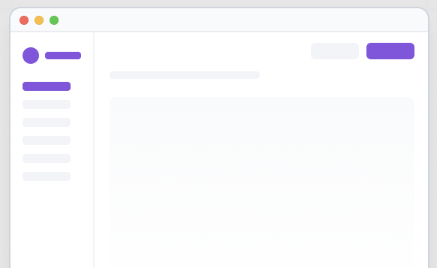



A Solution Template
The startup solution template
create new solution
a command-line utility
create new solution

Slide 4
Solution Template: Pains
Keep the solution template up-to-date!
Transfer fixes and improvements from solutions to the template.

Slide 5
Solution Template: Shortcomings
Configuring, fine-tuning or abstracting 3rd-party libraries
Helpers, base classes, extension methods, ASP.NET Core filters (exception handling, audit logging,…)
Generic infrastructure features, like multi-tenancy, BLOB storing, email sending, event bus integration…
A solution contains know-how, not only for the business, but also related to the infrastructure and architecture

Slide 6





The ASP.NET Boilerplate Project
=
+
NuGet packages
Web Application Framework
A STRONG INFRASTRUCTURE FOR MODERN WEB APPLICATIONS
Startup solution templates
9 years of active development (still going on)
10K Stars, 172 contributors, 230 releases
8,5M downloads on NuGet
5,000+ issues, 1,200+ PRs closed
MVC (Razor Pages)

Slide 7

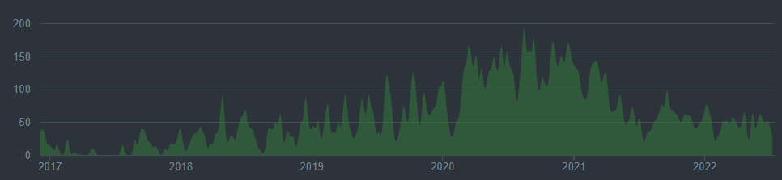
Evolution of ASP.NET Boilerplate
Microservices and distributed applications
Polyglot persistence
Complete modularity
Introduction of, .NET Core, ASP.NET Core & EF Core

Slide 8



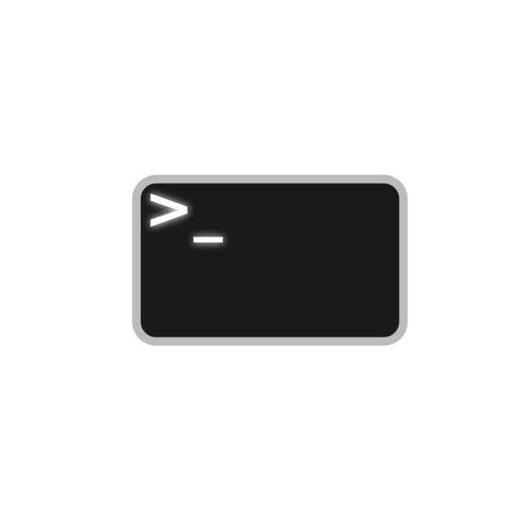















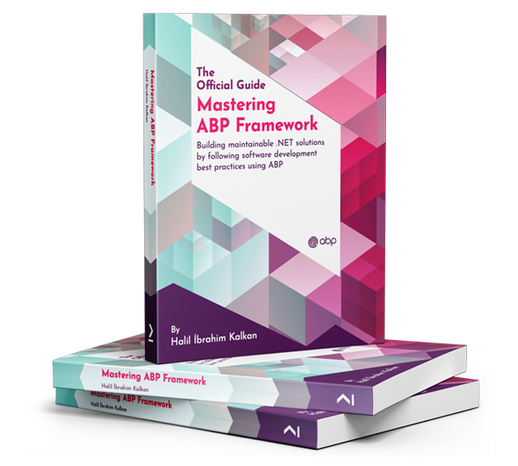



The ABP.IO Platform
Startup Templates
More Startup Templates
Framework Packages
CLI
Pro Themes
Basic Themes
Framework
Commercial
Pro Modules
Basic Modules
Examples
Docs & Books
Community
Events
eShopOnAbp
Discord
Articles
Video Tutorials
Blog

Slide 9
The Architecture
Domain Driven Design
& Layered Solution
Modular
Multi-Tenancy (SaaS infrastructure)
Microservice ready

Slide 10
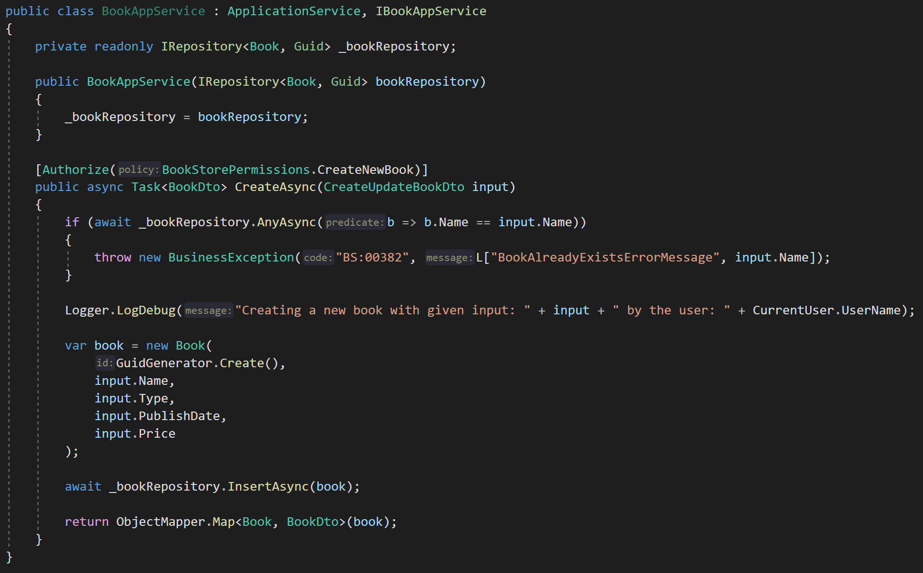
Don’t Repeat Yourself!
DDD Base Classes
DI Auto-Register
Generic Repositories
Authorization / Permissions
Auto Validation
Unit Of Work (Transaction Management)
Auto Audit Logging
Localization
Exception Management & Handling
ICurrentUser
ISettingProvider
IFeatureChecker
IGuidGenerator …
Object2Object Map

Slide 11
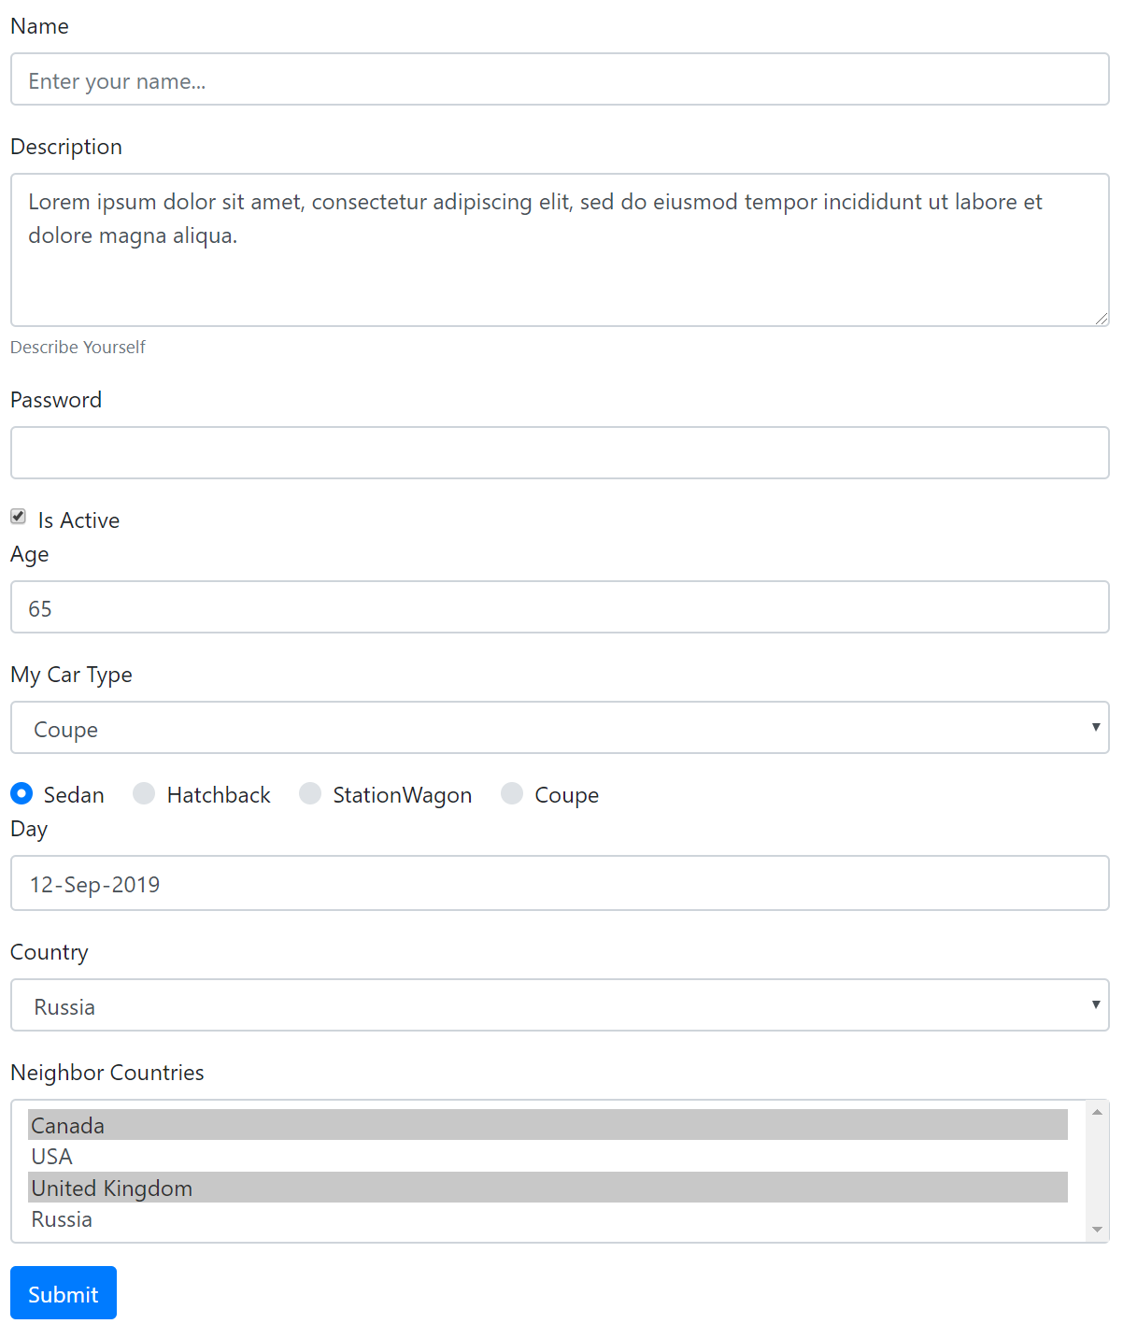
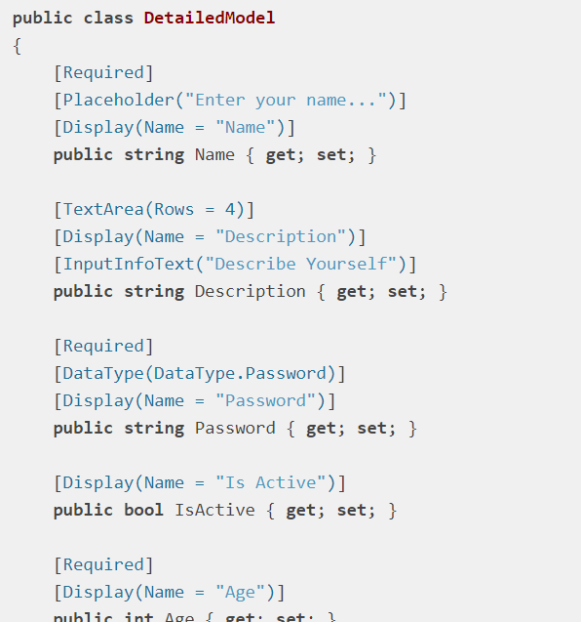
MVC Tag Helpers / Dynamic Forms
+Validation
+Localization

Slide 12


UI / Database Options

Slide 13


ABP.IO: Filling the Gap
Your Application
Focus on your own business code!
ABP.IO Platform
Architecture & Infrastructure for Real-World Business Applications
.NET Platform / ASP.NET Core
Web Application & HTTP Service Development Framework

Slide 14
ABP in Action!
DEMO
by Alper Ebiçoğlu

Slide 15
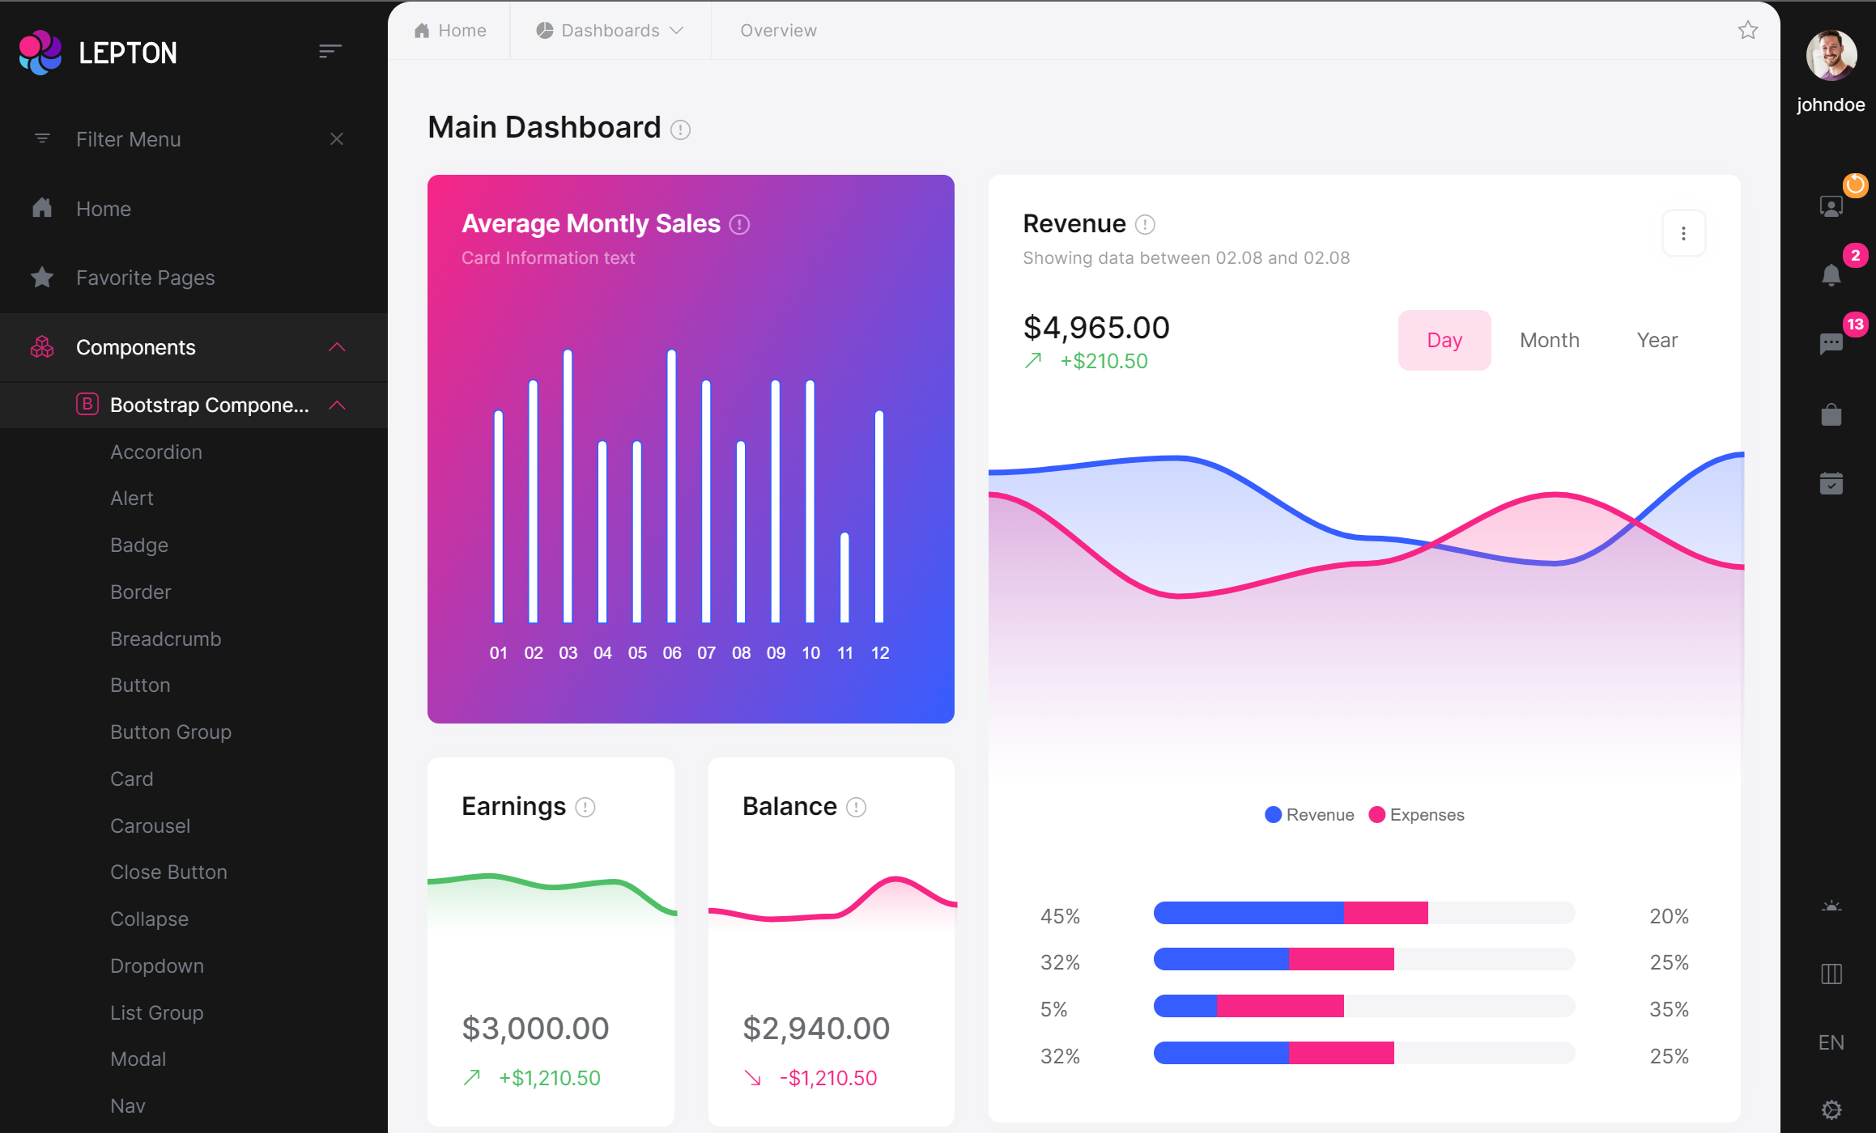
UI Theming

Slide 16
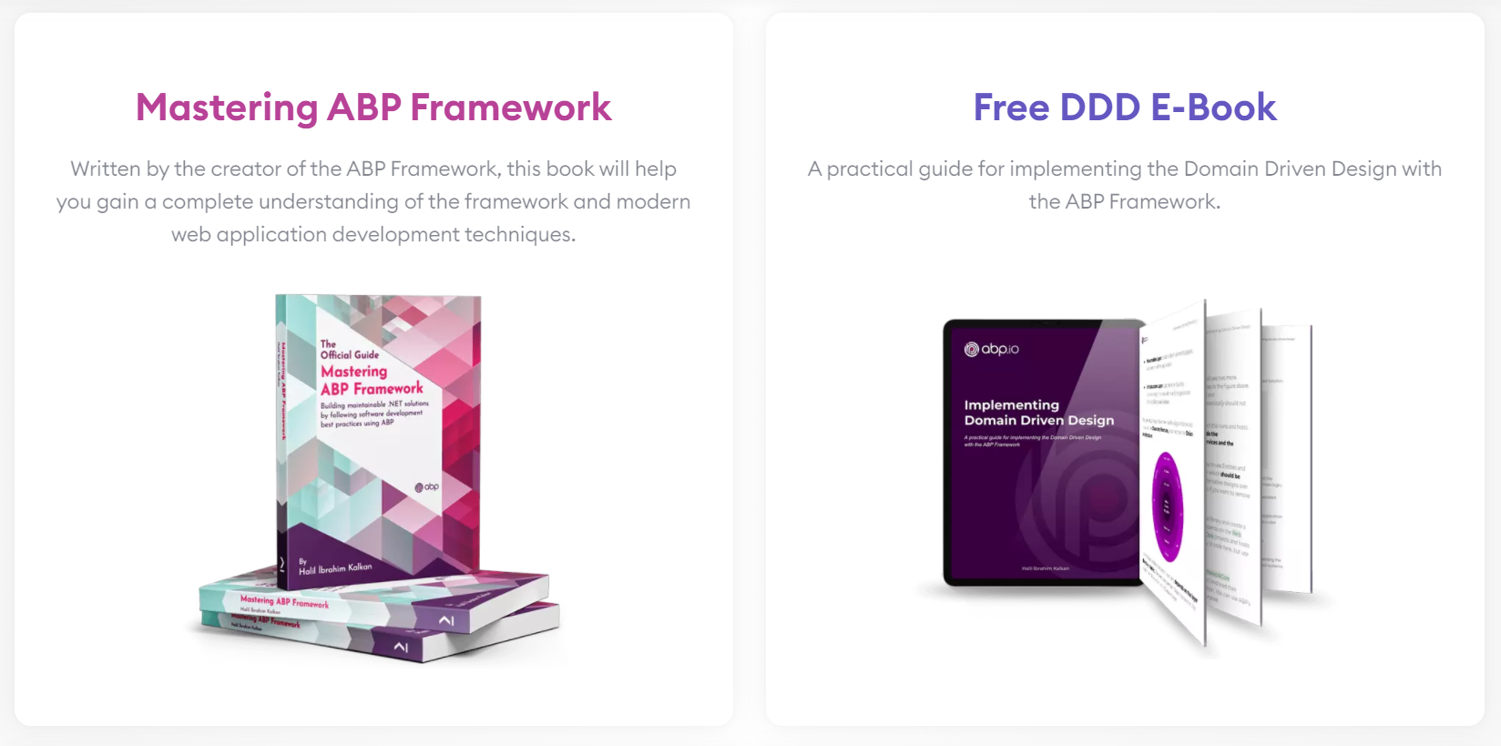
ABP Books
Coming soon Microservice Development with .NET and the ABP Framework

